Slide 1
Vrinda Store Data Analysis

Slide 2
Overview
The dataset for Vrinda Store (2022) includes customer information related to clothing product purchases. It provides insights into customer demographics, purchase behaviors, and preferences, allowing for segmentation and targeted marketing strategies.
Topics covered :
Size of the Data
Data Residing Location
Data Cleaning
Data Processing
Data Insights and Data Insights based on Graphs

Slide 3
Project objective:
Predict the sales for the next 6 months.

Slide 4
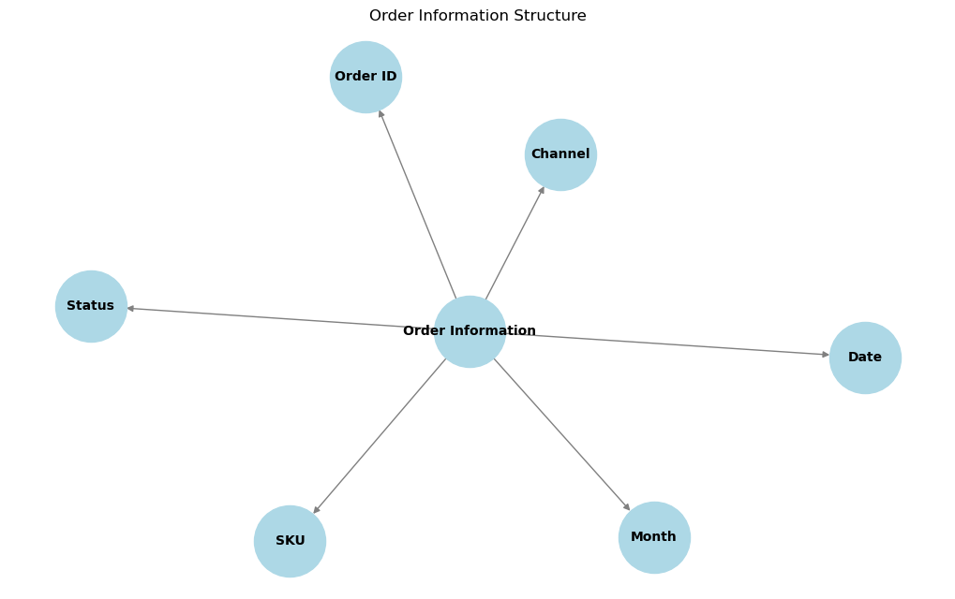
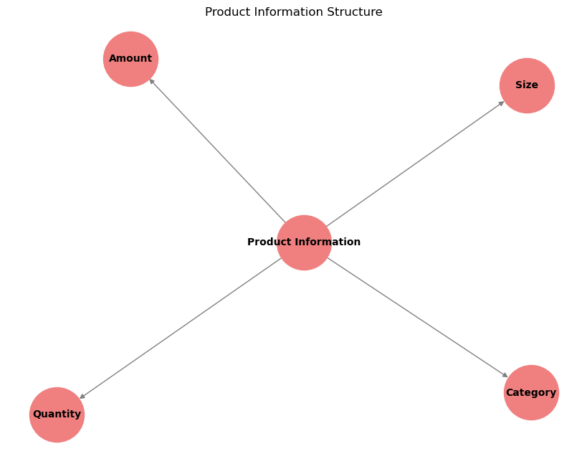
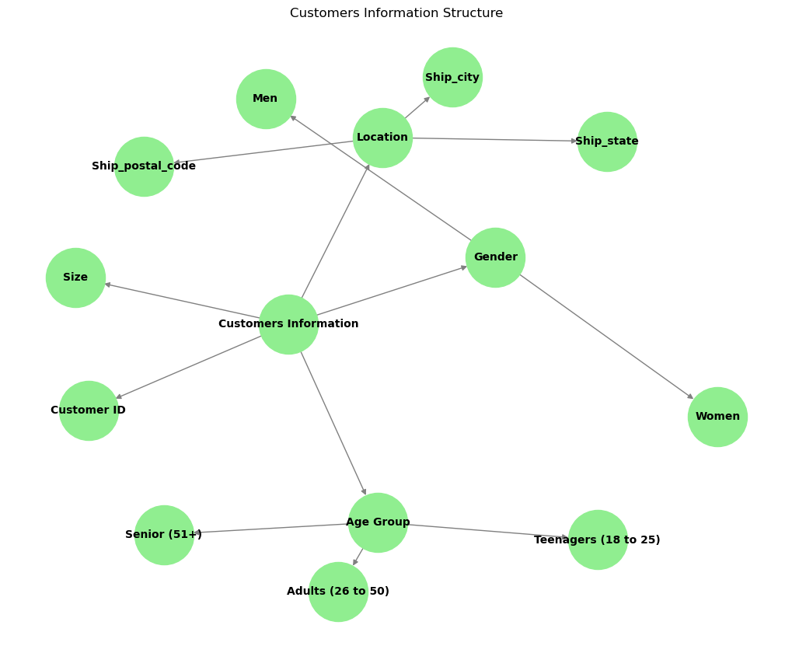
Size of the Data:
Total Number of Columns : 19
Total Number of Rows : 31047
Vrinda Data Store (2022)
—-> 1. Customers Information
Customer ID
Gender
Men
Women
Age
Group
Teenagers ( 18 to 25)
Adults (26 to 50)
Senior (51+)
Size
Location
Ship_city
ship_state
ship_postal_code
—->2. Order Information
Order Id
Month
Date
Status
Channel
SKU
—-> 3. Product Information
Category
Size
Quantity
Amount

Slide 5
Size of the Data:

Slide 6
Data Residing Location :
Data Source :
Excel/CSV file
Storage :
Google Sheets
Platform Used :
Google Sheets
Python (Jupyter Notebook)

Slide 7
Data Cleaning :
1. Data Observation and Create Filter Column
Observe the data and set filters on each column to facilitate easier analysis.
2. Problem - Check for Null Values and Repeated Values in the Data
Solution:
In Excel, apply filters on each column to identify and check for null values and repeated entries with different names.
No Null Values found in any columns and no repeated values in data.
3. Problem - Check in Gender Column for Data Cleaning
Solution:
Use filters to identify variations in the gender column (Men, M, Women, W).
Use Find and Replace to standardize the values:
Change all "M" to "Men"
Change all "W" to "Women"

Slide 8
4. Problem - Check Qty Column for Data Cleaning
Solution:
Apply filters to identify inconsistencies in the qty column (e.g., "One", "Two" as well as "1", "2").
Use Find and Replace to standardize the values:
Change "One" to "1"
Change "Two" to "2"
5. Problem - Check for Ship-City and Ship-State for Data Cleaning
Solution:
Identify inconsistencies in capitalization (e.g., uppercase vs. lowercase text).
Create a new column with the formula =TRIM(PROPER(value)) and apply it across all rows to standardize capitalization.
Copy the cleaned values and paste them as values in the original ship-city and ship-state columns.
Delete the new column created for cleaning.
Outcome:
All data is now cleaned and ready for further processing.

Slide 9
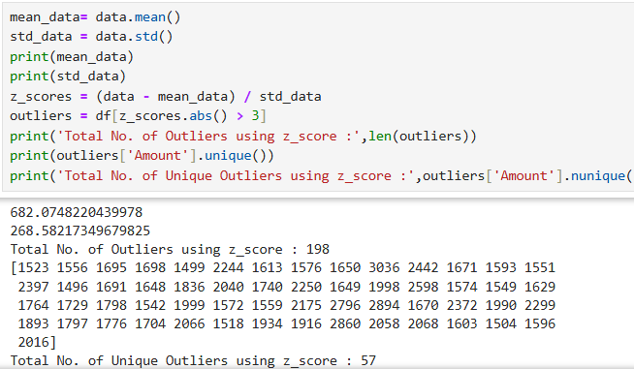
Data Processing:
Outliers
Problem -
Find the Total Numbers of Outliers.
Solution-
By Using Z-score Tests for only the numeric columns present in the Data we can find Total No. of Outliers in the data.
For Performing Z-score we use python(Jupyter Notebook).

Slide 10
Duplicates And Null Values
Problem -
Find the Duplicates and Null Values in the Data.
Solution-
By Using total_duplicates = df.duplicated().sum() having df as our dataframe “Vrinda Store “ and for Null Values we use null_values = df.isnull().sum().
Result-
Total duplicate rows: 0
Total null values: 0

Slide 11
Order Id and Customer Id:
We have to check the columns which are numericals and are unique for each customer in the data.
Therefore, We find the duplicates in the Order Id , Customers Id , Index as our primary key if no duplicates are found.
By using total_duplicate_order_ids = df['Order ID'].duplicated().sum() and total_duplicate_customer_ids = df['Customer ID'].duplicated().sum() in Python.
Result -
Total duplicate Order IDs: 2576 Total duplicate Customer IDs: 2610
Therefore,
Unique Order IDs: 28471 Unique Customer IDs: 28437
We can identify that we cannot remove the duplicates because they contain different category and amount in each, which means that the customer can be the same but buying different products from different channels.

Slide 12
Data Insights :
Gender:
Metrics for Women:
Total Amount Spent: 13562773.00
Average Amount Spent: 629.28
Total Items: 21553.00
Metrics for Men:
Total Amount Spent: 7613604.00
Average Amount Spent: 801.94
Total Items: 9494.00
Group:
Metrics for Adult:
Total Amount Spent: 12928106.00
Average Amount Spent: 682.87
Total Items: 18932.00
Metrics for Senior:
Total Amount Spent: 4026652.00
Average Amount Spent: 681.44
Total Items: 5909.00
Metrics for Teenager:
Total Amount Spent: 4221619.00
Average Amount Spent: 680.25
Total Items: 6206.00

Slide 13
Month:
Metrics for Dec:
Total Amount Spent: 1622033.00
Average Amount Spent: 680.38
Total Items: 2384.00
Metrics for Nov:
Total Amount Spent: 1615356.00
Average Amount Spent: 677.87
Total Items: 2383.00
Metrics for Oct:
Total Amount Spent: 1666662.00
Average Amount Spent: 687.57
Total Items: 2424.00
Metrics for Sep:
Total Amount Spent: 1688871.00
Average Amount Spent: 678.26
Total Items: 2490.00
Metrics for Aug:
Total Amount Spent: 1808505.00
Average Amount Spent: 691.06
Total Items: 2617.00
Metrics for Jul:
Total Amount Spent: 1772300.00
Average Amount Spent: 687.20
Total Items: 2579.00
Metrics for Jun:
Total Amount Spent: 1750966.00
Average Amount Spent: 674.23
Total Items: 2597.00
Metrics for May:
Total Amount Spent: 1797822.00
Average Amount Spent: 686.98
Total Items: 2617.00
Metrics for Apr:
Total Amount Spent: 1829263.00
Average Amount Spent: 681.29
Total Items: 2685.00
Metrics for Mar:
Total Amount Spent: 1928066.00
Average Amount Spent: 683.95
Total Items: 2819.00
Metrics for Feb:
Total Amount Spent: 1875932.00
Average Amount Spent: 682.16
Total Items: 2750.00
Metrics for Jan:
Total Amount Spent: 1820601.00
Average Amount Spent: 673.80
Total Items: 2702.00

Slide 14
Category:
Metrics for kurta:
Total Amount Spent: 4959377.00
Average Amount Spent: 474.76
Total Items: 10446.00
Metrics for Set:
Total Amount Spent: 10507546.00
Average Amount Spent: 848.00
Total Items: 12391.00
Metrics for Western Dress:
Total Amount Spent: 3148836.00
Average Amount Spent: 774.43
Total Items: 4066.00
Metrics for Top:
Total Amount Spent: 1186199.00
Average Amount Spent: 540.90
Total Items: 2193.00
Metrics for Saree:
Total Amount Spent: 1010471.00
Average Amount Spent: 732.23
Total Items: 1380.00
Metrics for Blouse:
Total Amount Spent: 140888.00
Average Amount Spent: 615.23
Total Items: 229.00
Metrics for Ethnic Dress:
Total Amount Spent: 195256.00
Average Amount Spent: 739.61
Total Items: 264.00
Metrics for Bottom:
Total Amount Spent: 27804.00
Average Amount Spent: 356.46
Total Items: 78.00

Slide 15
Channels:
Metrics for Myntra:
Total Amount Spent: 4941540.00
Average Amount Spent: 681.22
Total Items: 7254.00
Metrics for Ajio:
Total Amount Spent: 1331427.00
Average Amount Spent: 689.50
Total Items: 1931.00
Metrics for Amazon:
Total Amount Spent: 7519933.00
Average Amount Spent: 682.64
Total Items: 11016.00
Metrics for Flipkart:
Total Amount Spent: 4573301.00
Average Amount Spent: 682.28
Total Items: 6703.00
Metrics for Meesho:
Total Amount Spent: 927606.00
Average Amount Spent: 663.52
Total Items: 1398.00
Metrics for Others:
Total Amount Spent: 867241.00
Average Amount Spent: 687.74
Total Items: 1261.00
Metrics for Nalli:
Total Amount Spent: 1015329.00
Average Amount Spent: 684.18
Total Items: 1484.00

Slide 16
Size:
Metrics for XXL:
Total Amount Spent: 2677640.00
Average Amount Spent: 658.71
Total Items: 4065.00
Metrics for L:
Total Amount Spent: 3445476.00
Average Amount Spent: 669.80
Total Items: 5144.00
Metrics for S:
Total Amount Spent: 2923443.00
Average Amount Spent: 700.06
Total Items: 4176.00
Metrics for M:
Total Amount Spent: 3772230.00
Average Amount Spent: 687.74
Total Items: 5485.00
Metrics for XL:
Total Amount Spent: 2950033.00
Average Amount Spent: 664.87
Total Items: 4437.00
Metrics for XS:
Total Amount Spent: 1774580.00
Average Amount Spent: 708.98
Total Items: 2503.00
Metrics for 3XL:
Total Amount Spent: 2259099.00
Average Amount Spent: 674.96
Total Items: 3347.00
Metrics for Free:
Total Amount Spent: 1022905.00
Average Amount Spent: 726.50
Total Items: 1408.00
Metrics for 6XL:
Total Amount Spent: 152198.00
Average Amount Spent: 731.72
Total Items: 208.00
Metrics for 4XL:
Total Amount Spent: 79734.00
Average Amount Spent: 705.61
Total Items: 113.00
Metrics for 5XL:
Total Amount Spent: 119039.00
Average Amount Spent: 739.37
Total Items: 161.00

Slide 17
Qty:
Metrics for 1:
Total Amount Spent: 20977245.00
Average Amount Spent: 679.07
Total Items: 30891.00
Metrics for 2:
Total Amount Spent: 151786.00
Average Amount Spent: 1167.58
Total Items: 130.00
Metrics for 4:
Total Amount Spent: 14004.00
Average Amount Spent: 2334.00
Total Items: 6.00
Metrics for 3:
Total Amount Spent: 31167.00
Average Amount Spent: 1640.37
Total Items: 19.00
Metrics for 5:
Total Amount Spent: 2175.00
Average Amount Spent: 2175.00
Total Items: 1.00

Slide 18
Other Data Insights:
Total number of Unique SKU : 5287
Total number of Unique Ship-City: 1860
Total number of Unique ship-state: 36 ( It includes union territories )
Total number of Unique ship-postal-code: 4958
Key Insights:
Men spent an average of 801.94 INR, while women spent 629.28 INR. But, The total items purchased by women are more compared to men, So the total revenue made from women is more compared to men.
The average amount spent by the Groups are approximately the same. But, The total items purchased by the Adult group are higher than the Teenager group and the Senior group.
The month of March has the highest sale around the year having an average of 683.95 INR.
Total Items delivered throughout the year is 28641 which made the total revenue of the store of 1,97,10,544.00 INR.
The most sold item throughout the year 2022 is Set with 12391 purchases.Total amount spent on Set: 10507546.00 INR
The least sold category throughout the year 2022 is Bottom with 78 purchases.Total amount spent on Bottom: 27804.00 INR
Maharashtra leads in sales, contributing 4519 purchases and 29,90,221.00 INR of the total revenue.

Slide 19
The total number of items which are cancelled, refunded, returned and the amount the store has booked loss are :
Refunded:
Total Amount Spent: 264842.00 INR
Total Items: 517
Cancelled:
Total Amount Spent: 481844.00 INR
Total Items: 844
Returned:
Total Amount Spent: 719147.00 INR
Total Items: 1045
The most used channel to buy is Amazon with 11016 purchases.Total amount spent on Amazon: 7519933.00 INR
The total number of Unique SKU which are sold is 5287.
The orders are mostly by different customers but the customer ID 4984515 has purchased the maximum number of items, 12 items of amount 6489.00 INR.
The Total number of Customers which have done B2B is 177 and the total amount spend is 120221.00 INR.

Slide 20
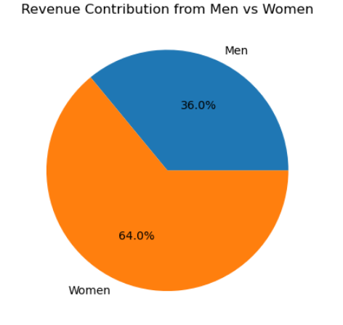
Insights Based on Graphs:
The pie chart of Revenue Contribution from Men vs Women is made in python.
It consists of percentage values based on values :
Total_revenue_men = 76,13,604.00 INR
Total_revenue_women = 1,35,62,773.00 INR
It shows that women have made a great contribution in the total revenue by 64%.

Slide 21
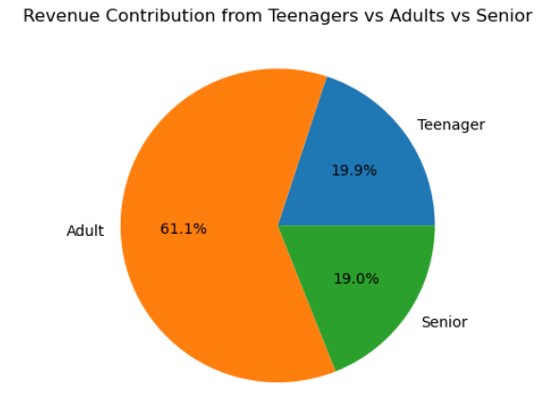
The pie chart of Revenue Contribution from Group column is made in python.
It consists of percentage values based on values :
Total_revenue_teen = 42,21,619.00 INR
Total_revenue_adult = 1,29,28,106.00 INR
Total_revenue_senior = 4026652.00 INR
It shows that Adults have made a great contribution in the total revenue by 61.1%

Slide 22
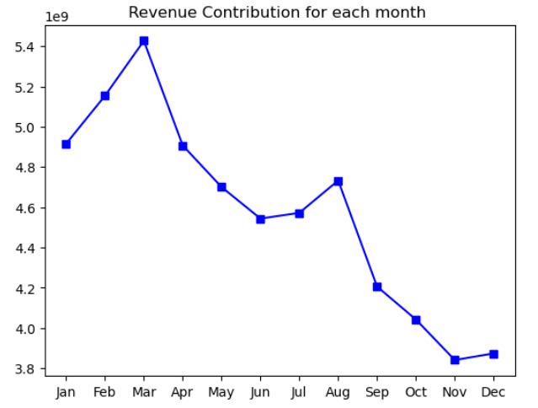
The line chart of Revenue Contribution for each month is made in python.
X - Axis : Months
Y - Axis : Total Revenue
Max: March month has 1928066.00 INR
Min: November month has 1615356.00 INR
It shows that there is a sudden drop in the total revenue from month of
Mar - Jun —-> -ve impact
Aug - Nov —-> -ve impact
But, The Revenue of the months from:
Jan - March —-> +ve impact
Jun - Aug —-> +ve impact

Slide 23
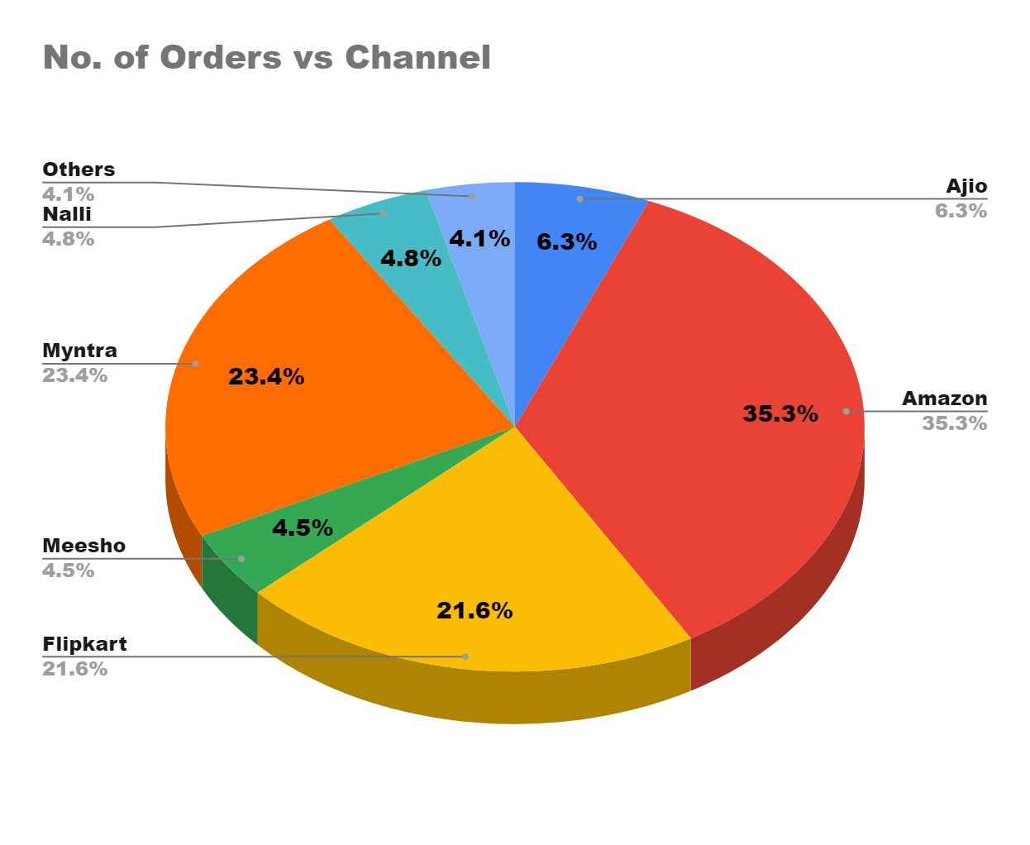
The 3D pie chart of No. of Orders vs Channel column is made in EXCEL.
It consists of percentage values based on Count of Orders through the Channel :
Max : Amazon is leading by approx. 35% of Total numbers of order in the year 2022.
It shows that Maximum of orders are from major 3 Channels which are Amazon, Myntra, Flipkart by approx. 80%.

Slide 24
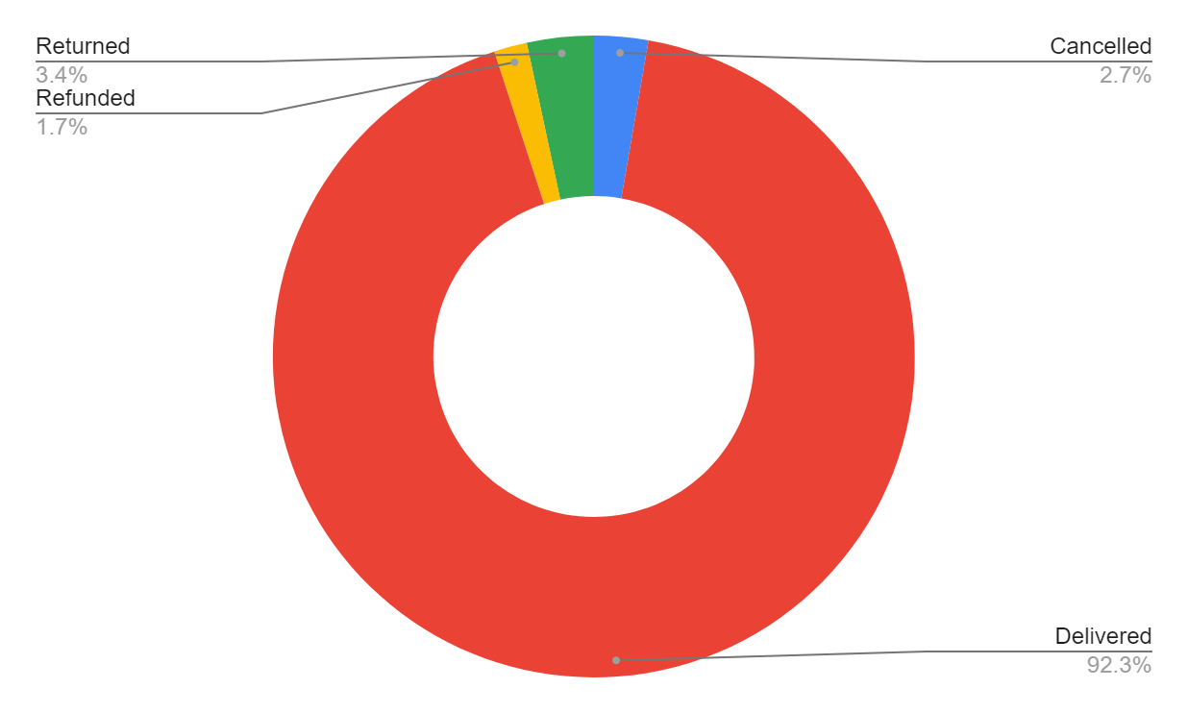
The Doughnut pie chart of Status column is made in EXCEL.
It consists of percentage values based on Count of Orders having Status :
Profit_booked_orders = approx. 92%
Loss_booked_orders = approx. 8%
It is very good for a company to have 92 % of the order as delivered and only 8% of the orders are returned, refunded or cancelled.

Slide 25
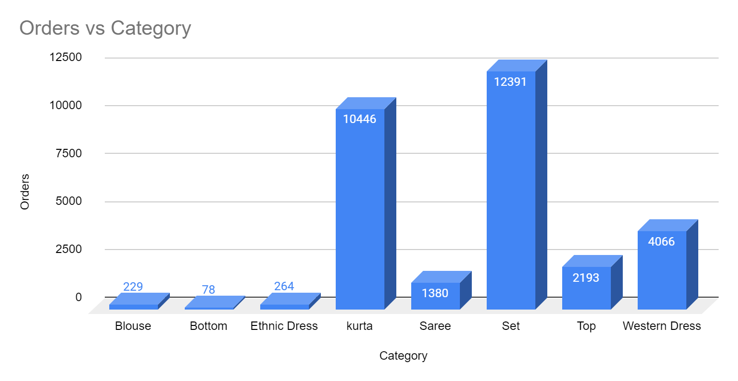
The Column chart of Orders vs Category is made in EXCEL.
It consists of Total number of orders from each Category which shows :
Max Ordered : Set has the maximum orders of 12391 delivered to the customers.
Min Ordered : Bottom Category has the minimum orders of 78 delivered to the customers.
The Graphs shows the booming products which are maximum ordered by the customers are Set and Kurta.

Slide 26
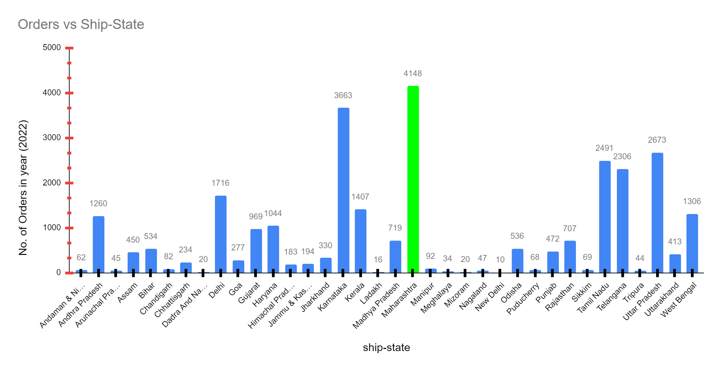
The Combo chart of Orders vs Category is made in EXCEL.
It consists of Total number of orders from each State which shows :
Max Ordered : Maharashtra has the maximum orders of 4148 delivered to the customers.
The Graphs shows that the major amount of orders are from the states Maharashtra, Karnataka, Uttar Pradesh and Tamil Nadu.

Slide 27
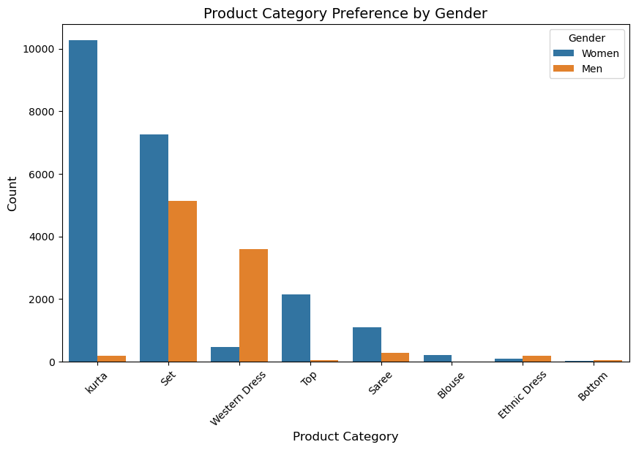
Hypothesis Testing :
Questions :
Is there a significant difference in the average amount spent by male and female customers?( Z test ) done
Does the average amount spent differ significantly across different age groups? (One Way Anova as 3 grp mean are present ) done
Are there significant differences in product category preferences between male and female customers? (Chi-square test of Independence as categorical variables of 2 grp) done
Is there a significant difference in the average total amount spent by B2B and B2C customers?( Z-test)(reject the null hypothesis) - using excel and python
Is there a significant difference in the total amount spent by customers from different shipping states? ( Not a Valid question)
Does the Qty differ significantly between different age groups of customers? (Chi -squareTest)
Are there significant differences in the preferred clothing size across different product categories? (Chi - Square Test for 2 categorical data)
Is there a significant variation in total revenue across different months of the year?(One -Way Anova)
Is there a significant difference in the no. of orders between B2B and B2C customers?(Z-test for proportion ) - internet used

Slide 28
Correlation :
Is there a correlation between the amount spent and the quantity of items purchased?
Is there a correlation between the age group of customers and the total amount spent?
Is there a correlation between the gender of customers and the total amount spent?
Is there a correlation between the order status and the total amount spent?
Is there a correlation between the month of purchase and the total amount spent?
Is there a correlation between the shipping state and the total amount spent?
Is there a correlation between the size of the product and the total amount spent?
Is there a correlation between the product category and the total amount spent?
Is there a correlation between the channel used and the total amount spent?
Is there a correlation between B2B column status and the total amount spent?

Slide 29
Thank You!

